Slide 1

Anemia Recognition
By : Infinity Team
Supervised by : Dr . Mona Elbedwehy

Slide 2

AGENDA
1.Introduction:
-What is ANEMIA ?
-What our project do ?
2. k-nearest neighbors algorithm (KNN):
-What is KNN ?
-KNN Algorism Accuracy.
3. Naïve Bayes classifier:
-What is Naïve Bayes?
- Naïve Bayes Algorism Accuracy.
Notes:
© Copyright Showeet.com – Free PowerPoint Templates

Slide 3

Introduction
Notes:
© Copyright Showeet.com – Free PowerPoint Templates

Slide 4
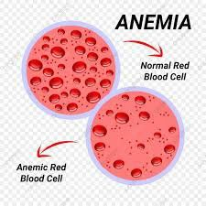
What is Anemia ?
Anemia is a condition in which you lack enough healthy red blood cells to carry adequate oxygen to your body's tissues. Having anemia, also referred to as low hemoglobin, can make you feel tired and weak.
Notes:
© Copyright Showeet.com – Free PowerPoint Templates

Slide 5
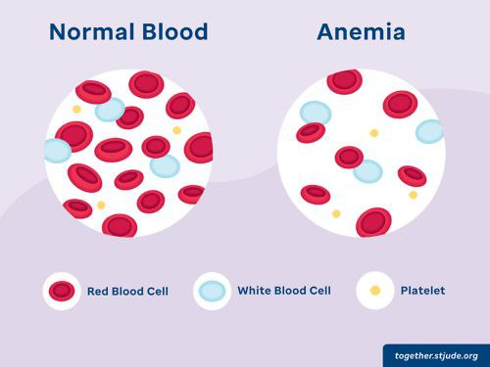
The project :
We start from database in excel form:
The number of cases: 1421
The number of patients with Anemia: 620
The number of healthy people: 801
This data contains 1421 general blood analysis and its results that shows if this case is an anemic man or no.
Our task is to find out if the new person who has a blood test is anemic or not.
We used more than algorithm to achieve this mission like KNN and Naïve Bayes classification algorithms.

Slide 6
k-nearest neighbors algorithm (KNN)
Notes:
© Copyright Showeet.com – Free PowerPoint Templates

Slide 7
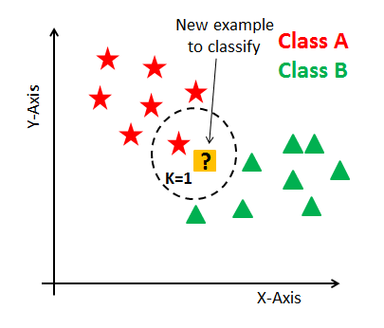
What is KNN ?
The k-nearest neighbors algorithm, also known as KNN or k-NN, is a non-parametric, supervised learning classifier, which uses proximity to make classifications or predictions about the grouping of an individual data point.
While it can be used for either regression or classification problems, it is typically used as a classification algorithm, working off the assumption that similar points can be found near one another.
Notes:
© Copyright Showeet.com – Free PowerPoint Templates

Slide 8
KNN Algorithm Accuracy.
The KNN algorithm accuracy is 97% almost.
True cases : 1385
False cases: 36
accuracy percentage: 97.47 %

Slide 9
Naïve Bayes classifier
Notes:
© Copyright Showeet.com – Free PowerPoint Templates

Slide 10
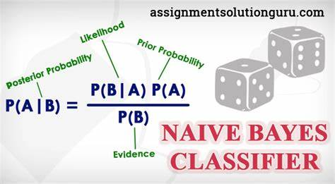
What is Naïve Bayes?
In statistics, naive Bayes classifiers are a family of simple "probabilistic classifiers" based on applying Bayes' theorem with strong (naive) independence assumptions between the features (see Bayes classifier). They are among the simplest Bayesian network models , but coupled with kernel density estimation, they can achieve high accuracy levels.
Naive Bayes classifiers are highly scalable, requiring a number of parameters linear in the number of variables (features/predictors) in a learning problem. Maximum-likelihood training can be done by evaluating a closed-form expression, which takes linear time, rather than by expensive iterative approximation as used for many other types of classifiers.

Slide 11
Naïve Bayes Algorithm Accuracy.
The Naïve Bayes algorithm is 93% almost.
True cases: 1328
False cases: 93
accuracy percentage: 93.46 %

Slide 12
Infinity team

Slide 13



OUR TEAM
Ammar elbadry
Ali sabry
Adel hassan​
IT
Id: 802320768
IT
Id:802267642
IT
Id:802319556

Slide 14


OUR TEAM
Mahmoud osman
Mostafa elzogby
Zyad abd elaziz​
IT
Id:802324202
cs
Id:802324707
cs
Id:802318243

Slide 15

THANK YOU

